Slide 1
Oppositional defiant disorder (ODD)
Name
Institutional affiliation
Date

Slide 2

What is Oppositional defiant disorder (ODD)
ODD refers to a neurological disorder caused by social, psychological and biological factors.
It is viewed as a behavioural disorder that affects children and adults at different life stages
It is common in a family that has a history of Attention Deficit Hyperactive Disorder
children with this disorder tends to be defiant, uncooperative and hostile towards teachers, parents and peers
Most of the victim of ODD are causes more troubles to mothers
Biologically, brain injuries is associated with ODD as it is linked to abnormal functioning of brain that affect behaviour of children
Genetically, children with this disorder, have relatives who has suffered metal illness some point in life
Child abuse and neglect, harsh discipline and poor supervision at early stages leads to this disorder among children
Notes:
This slide is describing what Oppositional defiant disorder (ODD) really is. It shows how the disorder is closely associated with biological, social and psychological factors. Hostility and trouble is linked to the Oppositional defiant disorder (ODD).

Slide 3


What causes Oppositional defiant disorder (ODD)
Images of ODD’S child
The studies have shown that, there is no clear cause of Oppositional defiant disorder (ODD)
However, there are contributing factors to this disorder which include
Genetics
Environment
Genetics shows that, Oppositional defiant disorder (ODD) is inherited from one generation to another
children with this disorder must have family member who have had mental illness and mood disorder, personality and anxiety disorder
Environmental where children are brought up has some factors that can lead to the ODD
Factors like dysfunctional family life, inconsistent discipline by care givers or even substance abuse leads to behavioural disorder among children

Slide 4
Continuation
Kids with this disorder has the following risk factors
Temperament
Parenting issues
Temperament:
child's finds it hard to control emotions and cannot tolerate frustrations or troubles
Parenting issues
This include neglect of a child and a child experience abuse inconsistence discipline
Notes:
This slides explains risk factors associated with this disorder
Temperament and parenting issues are key risks factors
Temperament:
child's finds it hard to control emotions and cannot tolerate frustrations or troubles
Parenting issues
This include neglect of a child and a child experience abuse inconsistence discipline

Slide 5
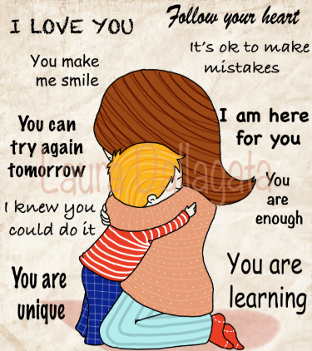
What measures are used to care for the infant or toddler?
There is a couple of measures that can be used to care for the infant or toddler
Firstly, parents should respond to their toddlers with anger but be calm and acknowledge ODD kid’s behaviour.
Notes:
This slides explains measure that can be used to take care of infant or toddlers
It is said that, parents should respond to their toddlers with anger but be calm and acknowledge ODD kid’s behaviour.
In addition to that practicing a positive parenting and improving child behaviour is helpfull

Slide 6


What measures are used to care for the infant or toddler?
Thirdly, as parents, there is a need to be consistent in following what ODD’s Kid is doing by following and monitoring their behaviour
Fourthly, parents can take care of ODD’s toddler by avoiding to take things personal. Child behaviour should not be taken personal. Consistent parenting is key
Notes:
The additional measures include a need to be consistent in following what ODD’s Kid is doing by following and monitoring their behaviour
Besides parents can take care of ODD’s toddler by avoiding to take things personal. Child behaviour should not be taken personal. Consistent parenting is key

Slide 7

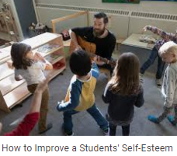
Continuation
How to support and care for an odd’s child
Supporting and improving child self-esteem
secondly, According to mayo clinics (2010) practicing a positive parenting and improving child behaviour is helpfull
Try as much as possible to restore self-esteem of ODD’s children so as to rebuild desired relationship between them and care givers
Give the kid a child to make choices
Do not to anything for them

Slide 8


Can they matriculate into the regular classroom with assistance?
It is a bit challenging to matriculate children with this disorder in a regular classroom.
However, with classroom assistance this is possible
Now this will need some special equipment
Some equipment like, toys, videos and television can be used

Slide 9

What equipment is used to care for them?
Since oppositional defiant disorder interferes with development of child's behaviour, I thing equipment or resources like toys can be used to care for them
Toys can be used to enable the kids to play and interact with one another
Also, toys can used to reward ODD’s kid that does what they have been told to do
Through successful interactions behaviour is positively shaped
Television and videos can be used to show them social interactions while entertaining them
Financial resources can be used to motivate them when a positive or desired behaviour is realized
Notes:
This slides describes equipment that can be used to care for oppositional defiant disorder kids

Slide 10
Reference
Mayo clinic (2020). The oppositional defiant (ODD). disorderhttps://www.mayoclinic.org/diseases-conditions/oppositional-defiant-disorder/symptoms-causes/syc-20375831

